Slide 1
eSmartlib RHSTI: An Enhanced Library Borrowing and Returning System Using QR Codes and Scanner, with Time-In/Time-Out Attendance
Proponents:
Lacheca, Charles Kenneth
Sulit, John Lloyd
Rada, Ahron Melvin
Lozano, King Jasper
Asis, Karen Claire
Laguador, Jake
Entong, Eduard John
Era, Ken James
Sarte, Tim Jaztin
Bascos, Francis
Turla, Alexander
Jalimao, John Vincent
Agripa, John Carlo
College of Computer Studies, Mabini Colleges, Inc. | Bachelor of Science in Computer Science | Software Engineering 2 | Instructor’s Name: Aeron Dave C. Enova | 1st Semester 2026-2027

Slide 2
2
Existing System
System Owner
Purpose of the Existing System
Users
RHSTI Library Management System – RHSTI library (system owner)
A web-based system used to manage library resources, student records, and library transactions.
Librarian / Administrator
Student / Library User
Current Functions
Current Implementation
Operational Status
Home Dashboard, Admin Account, Student module, Books module, Borrowing module, Returning module, Quick Management Shortcuts, Events Gallery
Web-based system; uses its existing database to store student, book, borrowing, and returning records.
The existing RHSTI Library Management System provides the basic functions necessary for managing students, books, borrowing transactions, and returning transactions.

Slide 3
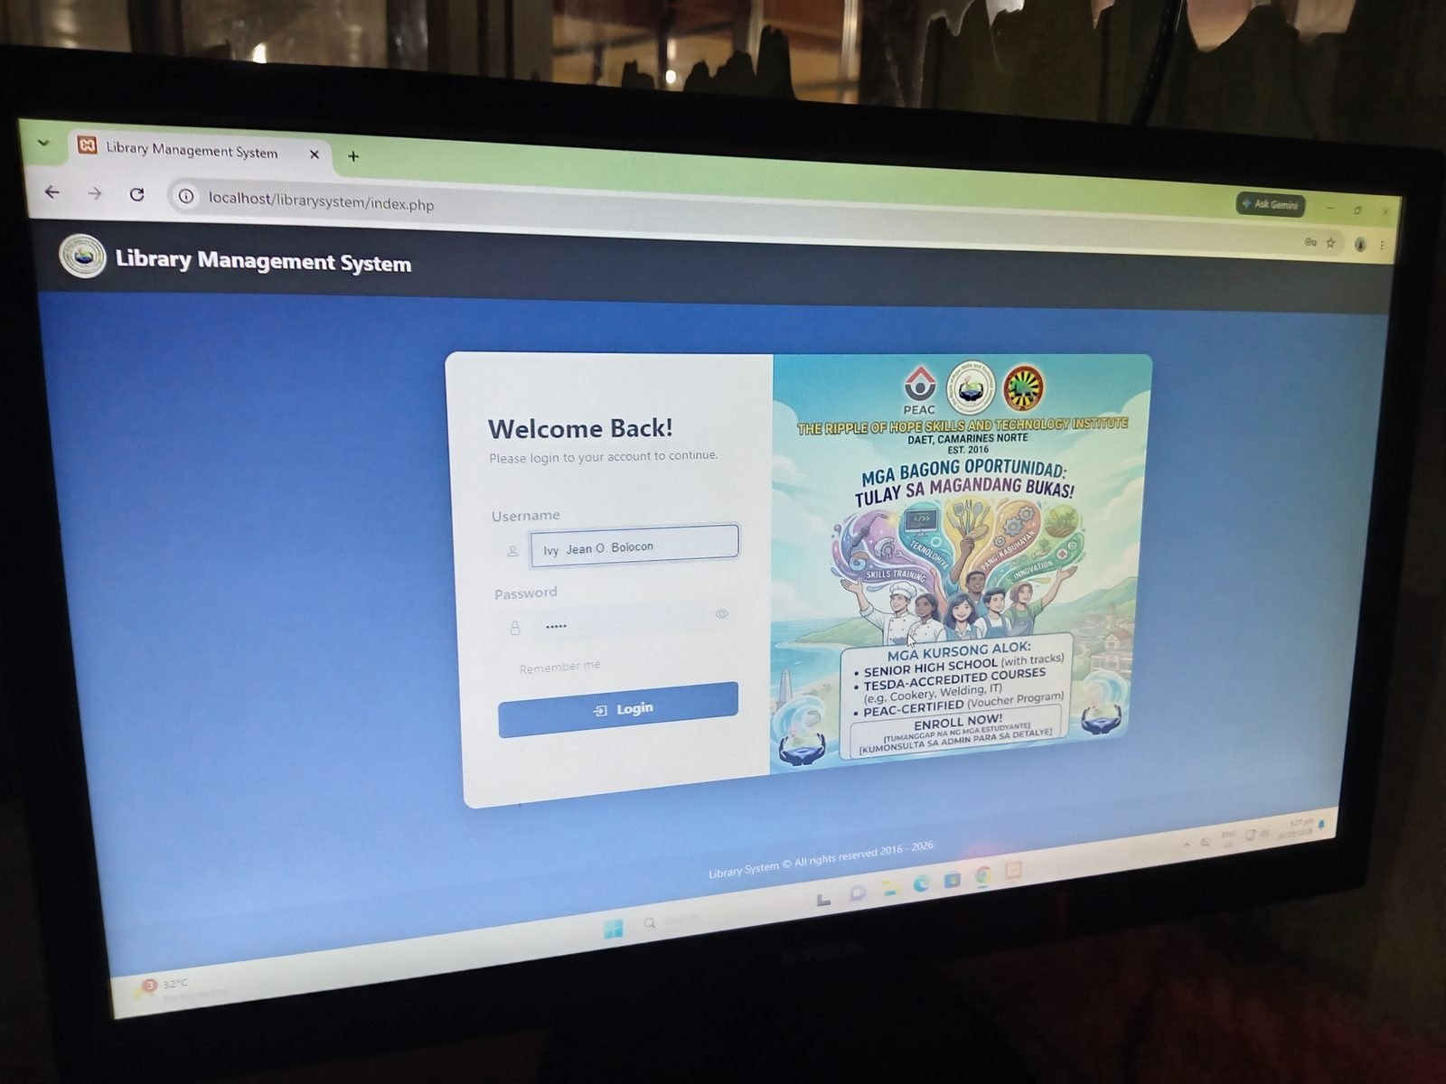
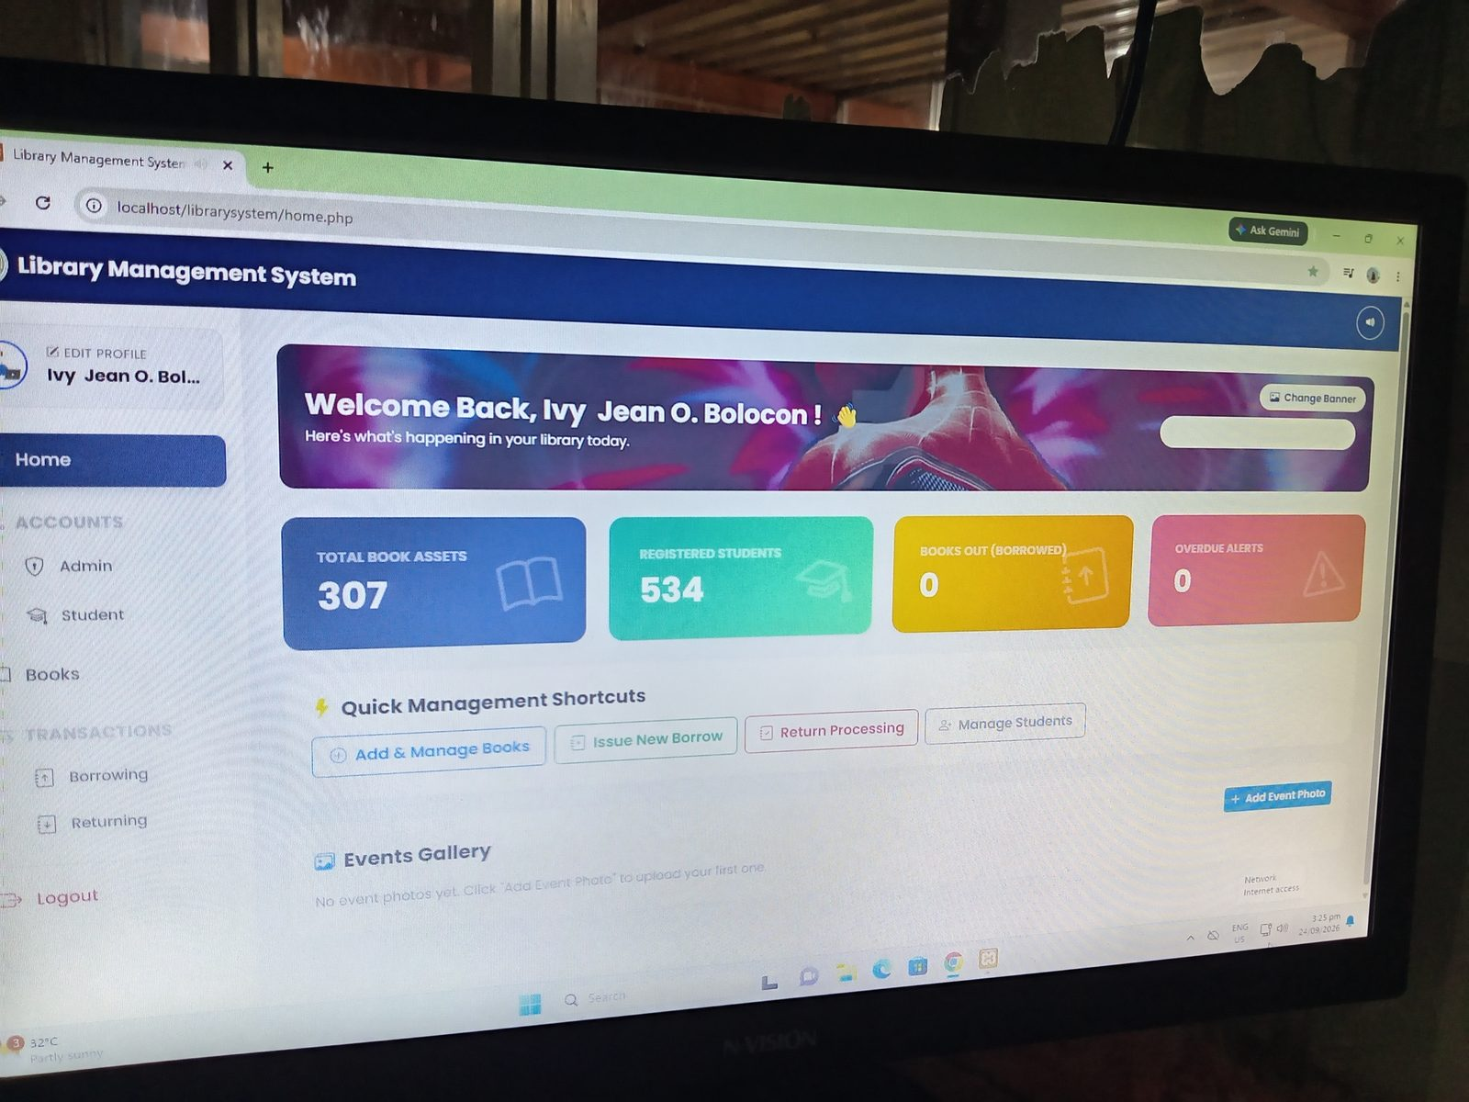
3
Existing System – Login and Home Dashboard
Login page
Home dashboard with summary counts and shortcuts

Slide 4
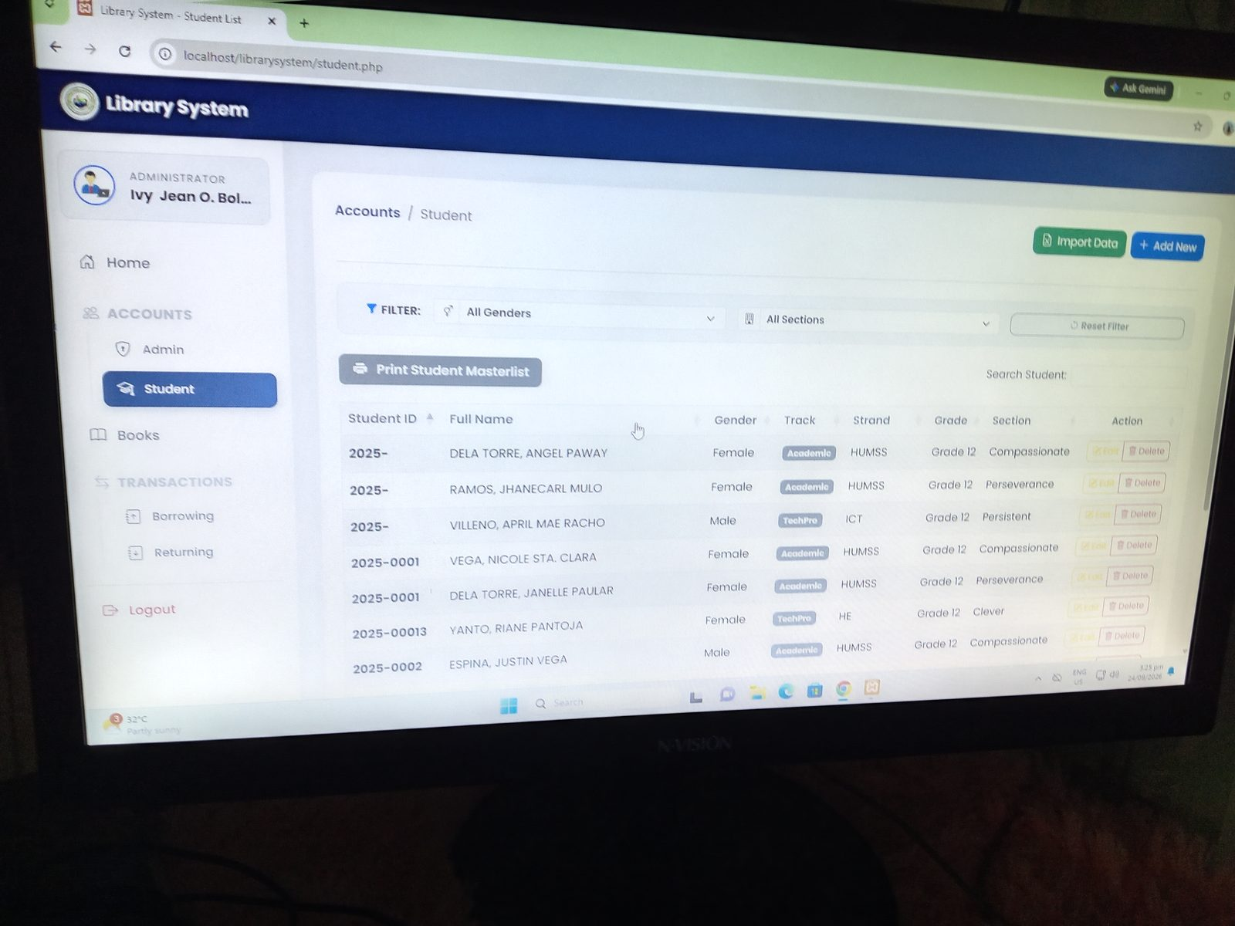
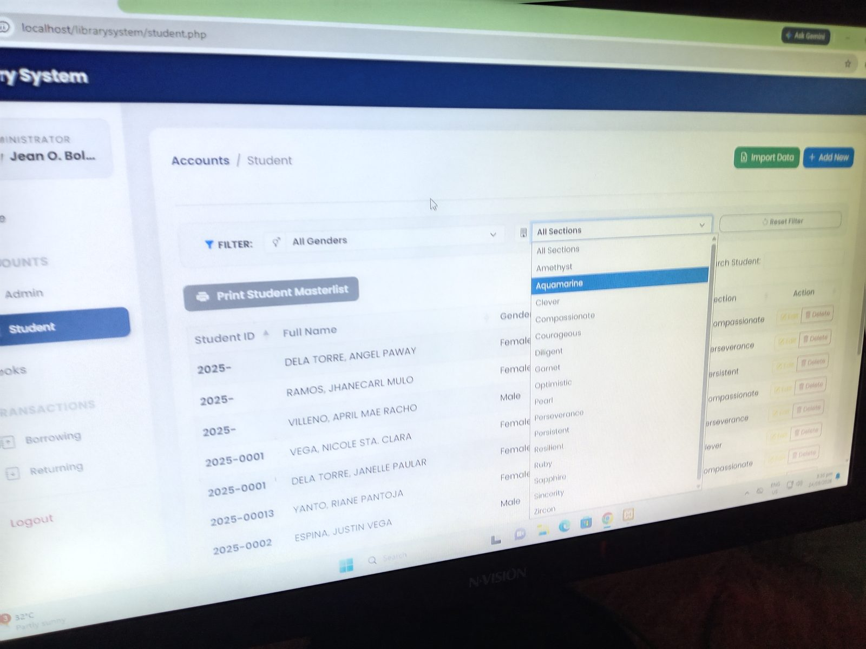
4
Existing System – Student Module
Student list with Track, Strand, Grade, Section
Filter by section (gender filter also available)

Slide 5
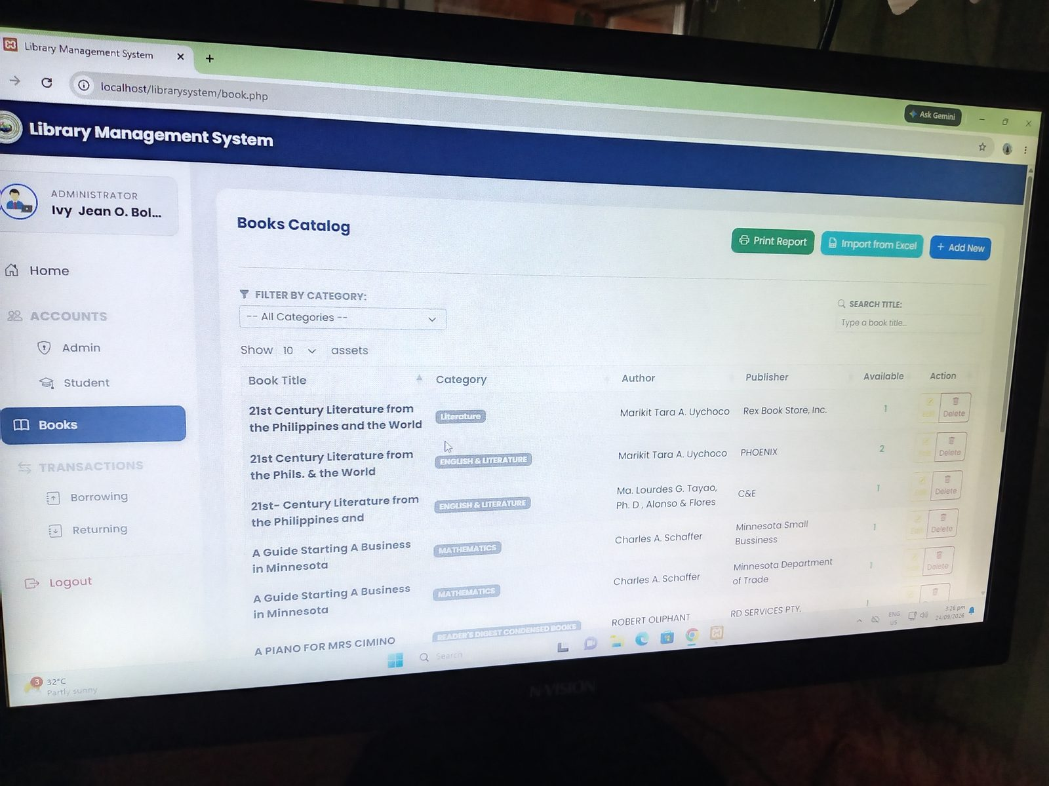
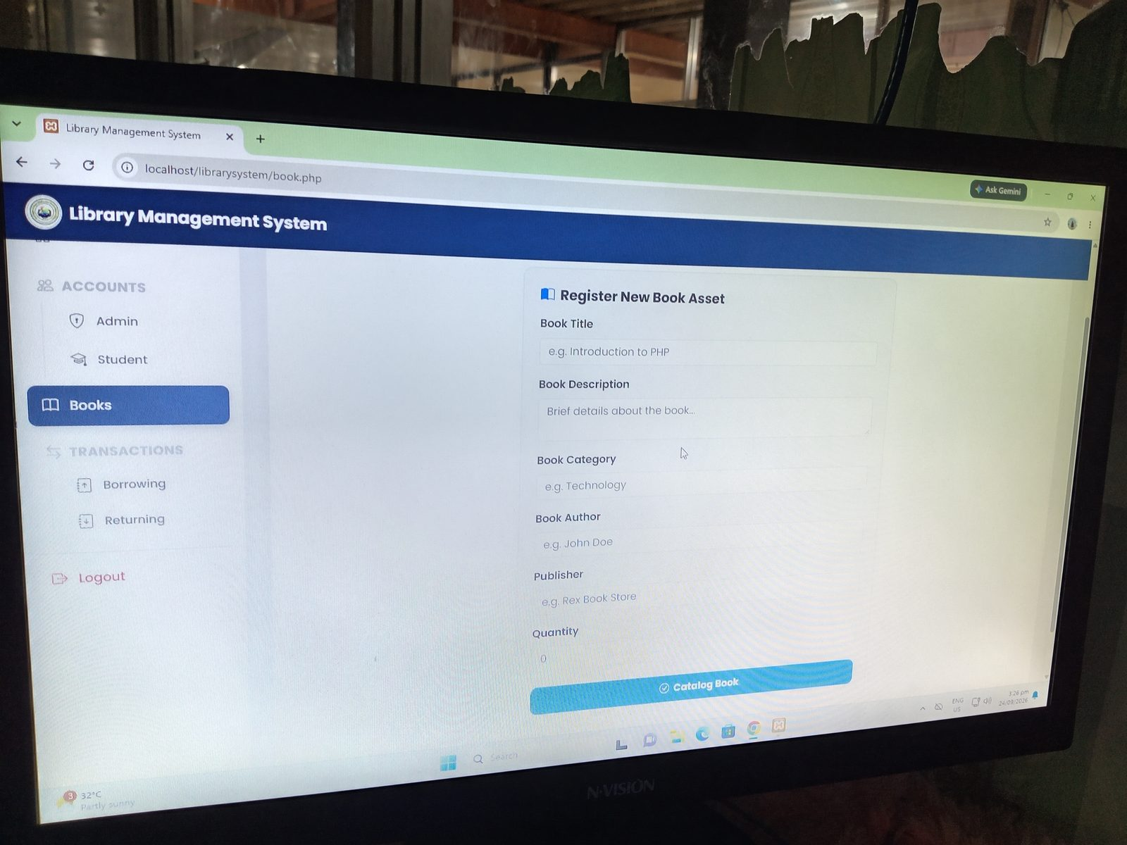
5
Existing System – Books Module
Books catalog with category filter and search
Register New Book Asset form

Slide 6
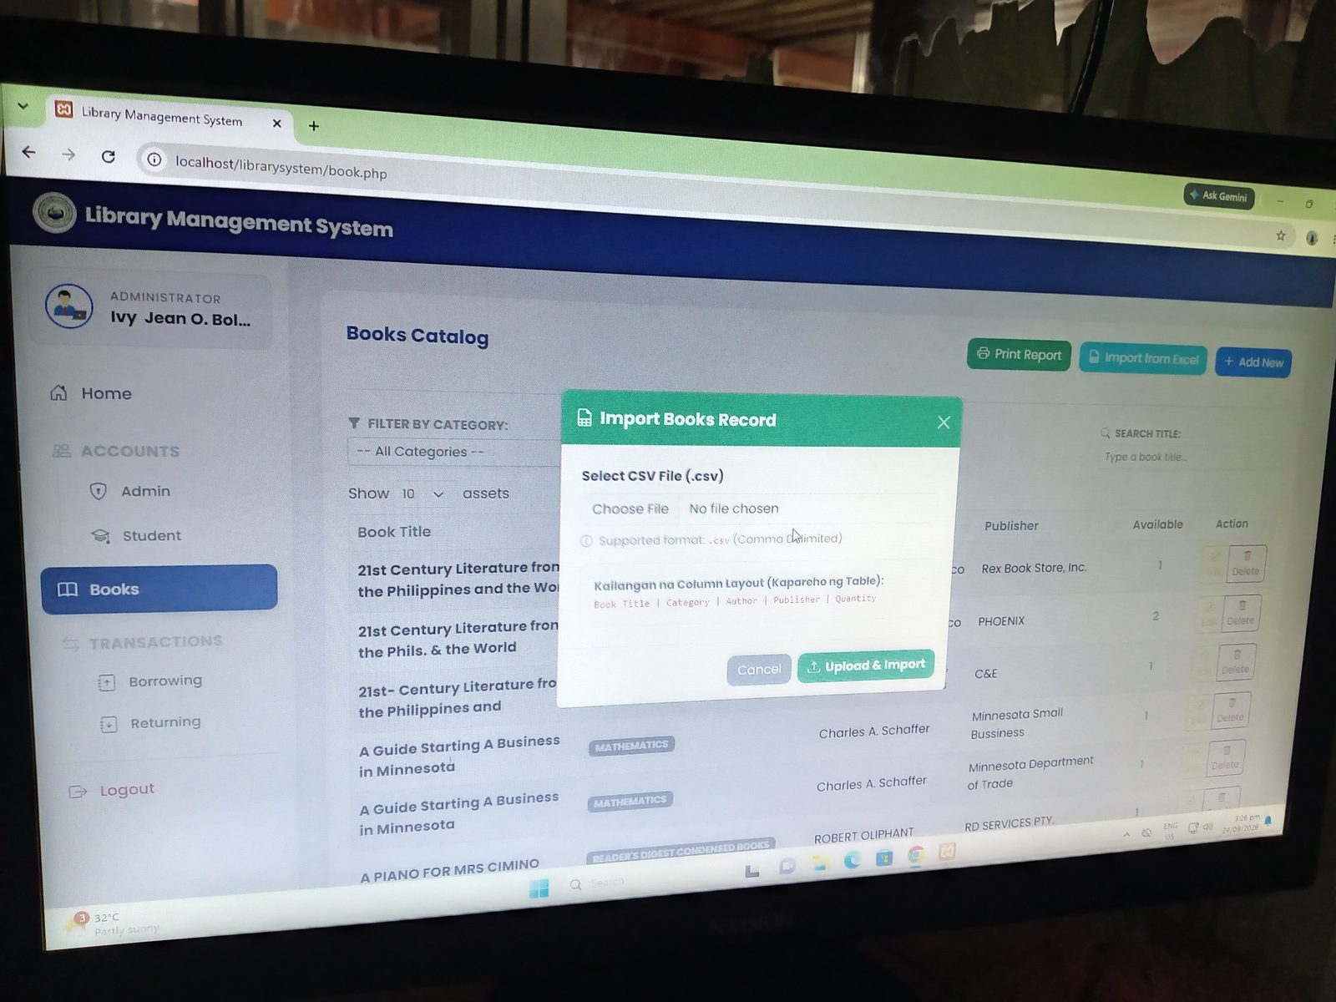
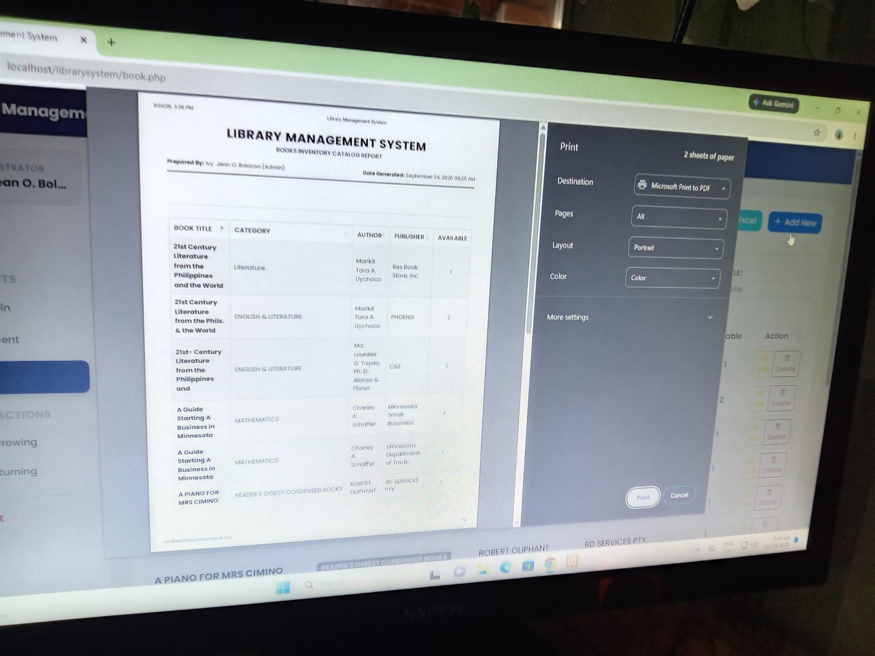
6
Existing System – Books Import and Report
Import Books Record via CSV
Print Books Inventory Catalog Report

Slide 7
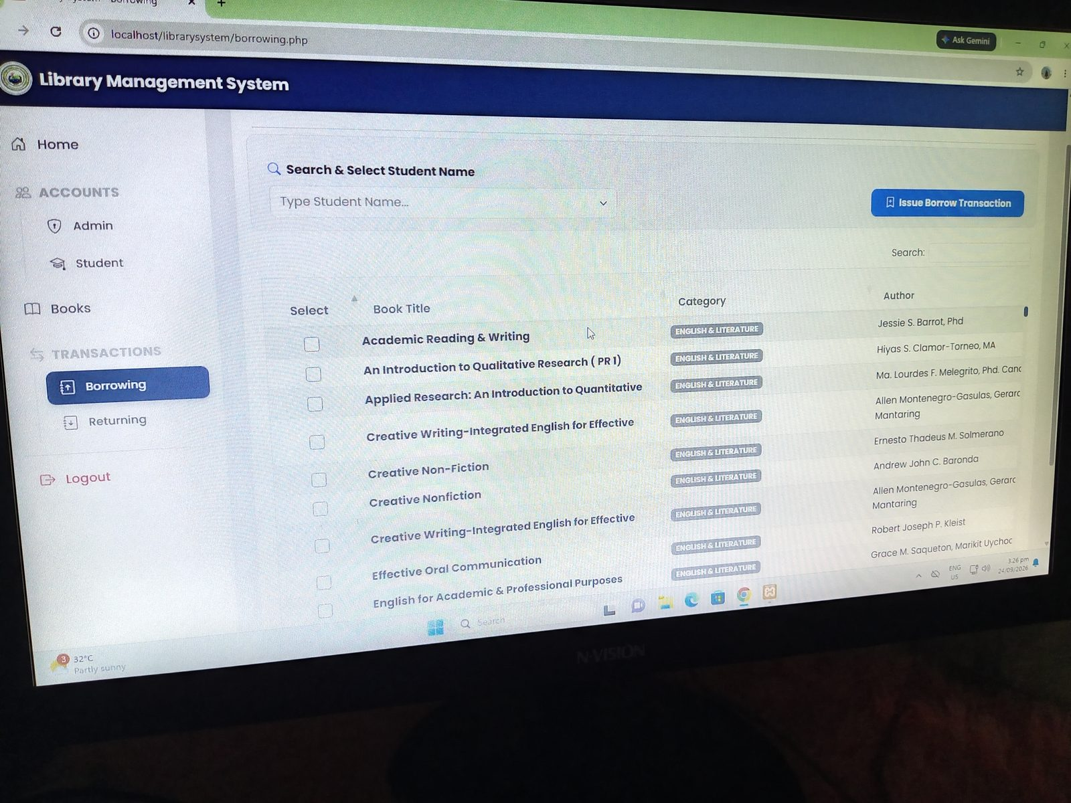
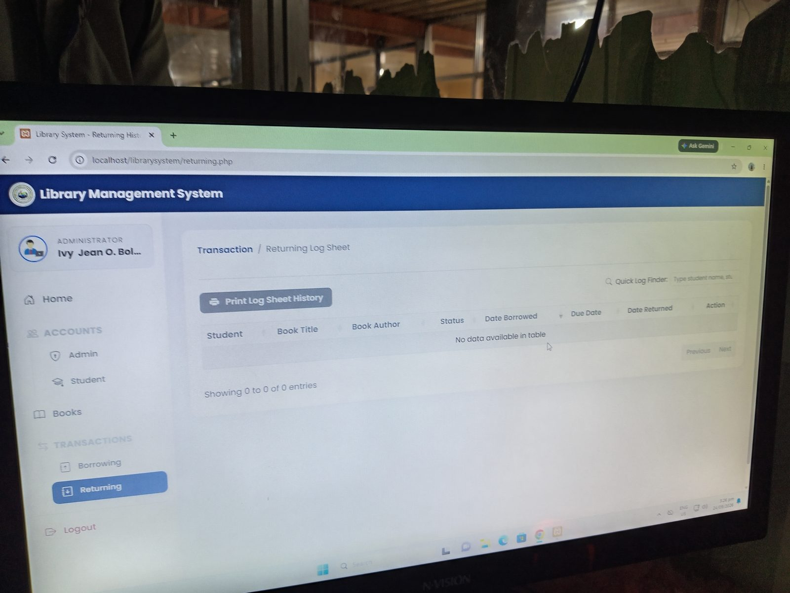
7
Existing System – Borrowing and Returning
Borrowing: select student and books
Returning log sheet

Slide 8
8
Existing System vs. Proposed System
Existing System | Proposed Enhancement
Home Dashboard, Student, Books, Borrowing, and Returning modules. The administrator selects the student and the books to be borrowed. | QR code generation for students and books; QR/scanner-based borrowing and returning; scanner-based Time-In/Time-Out attendance.
Web-based system that uses its existing database to store student, book, borrowing, and returning records. | HTML, CSS, PHP, JavaScript, MySQL, XAMPP, system-generated QR codes with scanner, Role-Based Access Control.
Manual searching or selection of student and book records during library transactions. | Each student and book can be provided with a system-generated QR code that can be scanned to identify the record.
Administrator selects the student and the books to be borrowed; returning records the returning log. | Student QR Scan → Student Identification → Book QR Scan → Book Identification → Borrowing Validation → Save Transaction → Update Book Availability.

Slide 9
9
Problem/Gap Identification
The main gaps addressed by the proposed enhancement are:
Manual searching or selection of student and book records during library transactions.
1
Additional processing steps during borrowing and returning.
2
Need for faster and more consistent identification of students and books.
3
Need for an organized scanner-based method of recording student time-in and time-out.
4
Need for centralized digital records that can support monitoring and reporting.
5

Slide 10
10
Proposed Technology
The proposed system will use a web-based application with a centralized MySQL database, developed and tested using XAMPP. The system will integrate QR code generation and scanner technology to enhance the existing library borrowing and returning processes and support time-in/time-out attendance.
Frontend
Backend
Database
HTML, CSS
PHP, JavaScript
MySQL
Development Environment
QR Code and Scanner
Attendance
XAMPP
System-generated QR codes for students and books, with scanner-based identification for borrowing and returning transactions
QR code scanning for student time-in/time-out recording
Authentication
Reporting/Analytics
Deployment
Role-Based Access Control
JavaScript-based charts or similar visualization tools
Local server or web server, depending on the approved project requirements

Slide 11
11
System Architecture
Student / Library User
QR Code
QR Scanner
eSmartlib RHSTI Application
→
→
→
↓
Student / Book Identification
Borrowing / Returning / Time-In-Time-Out Processing
Existing Database
Reports and Monitoring
→
→
→
Student / Library User → QR Code → QR Scanner → eSmartlib RHSTI Application → Student / Book Identification → Borrowing / Returning / Time-In-Time-Out Processing → Existing Database → Reports and Monitoring

Slide 12
12
Use Case Diagram/User Story
User Story 1 - As a student, I want my QR code to be scanned so that the system can identify my library record quickly.
User Story 2 - As a library personnel, I want to scan a student's QR code and a book's QR code so that a borrowing transaction can be recorded efficiently.
User Story 3 - As a library personnel, I want to scan a book's QR code during borrowing so that the system can identify the selected book and record it under the student's borrowing record.
User Story 4 - As a library personnel, I want to scan a book's QR code during returning so that the system can retrieve the corresponding borrowing record and record the return.
User Story 5 - As a library personnel, I want to scan the book's QR code when it is returned so that the system can update the book's status and make it available for borrowing again.
User Story 6 - As a library personnel, I want to record the borrowing date and due date so that the system can monitor when borrowed books should be returned.
User Story 7 - As a student, I want to scan my QR code for time-in/time-out so that my attendance can be recorded automatically.
User Story 8 - As an administrator, I want the system to store scanned borrowing, returning, and attendance records so that they can be monitored and reported.

Slide 13
13
Gantt Chart/Development Timeline
Development Phase
W1
W2
W3
W4
W5
W6
W7
W8
W9
W10
W11
W12
Analyze existing system
Design QR code and scanner features
QR code generation
QR-based borrowing and returning
Time-In/Time-Out attendance
Integration with existing database
Testing and documentation
Core QR-based transaction and attendance functions are developed first, while maintaining the existing library management features as the foundation.

Slide 14
14
SDG Alignment
Education
Economy
Agriculture
The proposed enhancement supports education by improving the management and accessibility of library services. Faster borrowing and returning can help students and library personnel process transactions more efficiently. The attendance component can also provide organized records of student visits and participation in library-related activities.
The proposed system can contribute to operational efficiency by reducing repetitive manual identification and recording. By automating parts of the borrowing, returning, and attendance processes, library personnel can spend less time on repetitive transaction encoding and more time on other library responsibilities.
The proposed system can support agricultural education when the RHSTI library contains agricultural books, references, or other agricultural learning resources. By improving the management, borrowing, returning, and monitoring of these resources, the enhanced system can help students access agricultural information more efficiently. The specific agriculture-related contribution should be finalized based on the actual agricultural resources and activities available at RHSTI.

Slide 15
15
Technological Justification
QR codes and scanner technology are appropriate for the proposed enhancement because they provide a simple and direct method of identifying records. A unique QR code can represent a student or book identifier, while the scanner provides a fast way to submit that identifier to the system.
Appropriate
The technology addresses the identified gap by reducing the need to repeatedly search for or manually encode student and book information during borrowing and returning. The same student QR identification can support time-in/time-out attendance recording, allowing the system to capture the date and time of the scan.
Necessary
The proposed enhancement is technically feasible because it builds upon the existing RHSTI Library Management System rather than requiring a completely new system. The existing student, book, borrowing, and returning modules can remain as the foundation, while QR generation, scanning, and attendance functionality are integrated into the appropriate processes.
Feasible

